Slide 1
Reasoning with Uncertain Information

Slide 2
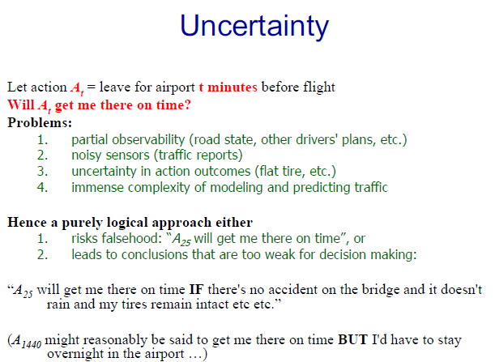

Slide 3
Sources of uncertainty
Imprecise model of the environment (medical diagnosis, weather forecast)
Stochastic environment (random processes, people moving)
Limited computational resources (chess, optimal VLSI Layout)
Limited communication resources (distributed systems, no global view)

Slide 4
Sources of uncertainty cont.
Noisy sensory data (object identification and tracking)
Exceptions to our knowledge can never be fully enumerated (birds fly, starting a car)

Slide 5
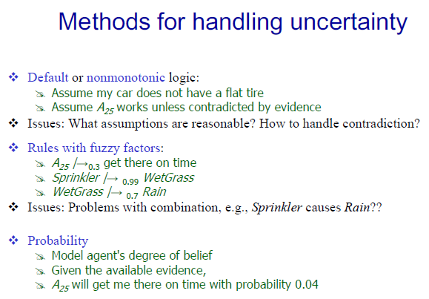

Slide 6
Random variables
Represent the result of random experiments.
Notation: x, y, z represent particular values of the variables X, Y, Z.
Sample space - the domain of a random variable (set of all elementary events).
Ex. Sample space = graduating students.
Elementary events = {John, Mary, ...}
Event set = Females graduating in civil engineering

Slide 7
Unconditional or prior probability of A – the degree of belief in A in the absence of any other information – P(A)
A – random variable
Probability distribution – P(A), P(A,B)
Example
  P(Weather = Sunny) = 0.1
  P(Weather = Rain) = 0.7
  P(Weather = Snow) = 0.2
Weather – random variable
P(Weather) = (0.1, 0.7, 0.2) – probability distribution
0 ≤ p(X₁, ..., X_{n}) ≤ 1 for any assignment of values to the variables
Σp(X₁, ..., X_{n})=1 where the summation is over all values of the variables
P(A ∨ B) = P(A) + P(B) - P(A ∧ B)
P(A ∨ ~A) = P(A)+P(~A) –P(false) = P(true)
P(~A) = 1 – P(A)

Slide 8
Joint probability functions
Given r.v.s X₁, ..., X_{n}, the joint probability function p(X₁, ..., X_{n}) assigns a probability to each set of possible values of the variables. Example:
Toothache ¬Toothache
Cavity 0.04 0.06
¬Cavity 0.01 0.89
From the joint distribution we can compute the probability of any complex proposition such as: p(Cavity v Toothache) or p(Cavity | Toothache)

Slide 9
Using the joint prob. function
(B, M, L, G) Joint prob
p(B = b, M = m, L = l, G = g), where b, m, l, and g are
either true or false
(T, T, T, T) 0.5686
(T, T, T, F) 0.0299
(T, T, F, T) 0.0135
(T, T, F, F) 0.0007
(T, F, T, T)
(T, F, T, F) . . .
(T, F, F, T)
(T, F, F, F)
(F, T, T, T)
(F, T, T, F)
(F, T, F, T)
(F, T, F, F)
(F, F, T, T)
(F, F, T, F)
(F, F, F, T)
(F, F, F, F)
Marginal probability
p(B = b) = Σ p(B, M, L, G)
B=b
each between
0 and 1 and all
sum to 1
sum of 8 joint probs.
p(B = b,M = m) = Σ p(B,M,L,G)
B=b,M=m
sum of 4 joint probs.

Slide 10
Conditional Probability
The notation p(X|Y) refers to the two dimensional table: p(X=x_{i}|Y=y_{i})
Conditional probability can be defined in terms of unconditional probabilities:
p(X | Y) = p (X, Y) / p(Y) when p(Y) > 0
p(X, Y) = p(X | Y) p(Y) (the product rule)
Can condition on several vars:
p(X | Y, Z) = p(X,Y,Z)/p(Y,Z) = p(X,Y | Z)/p(Y | Z)

Slide 11
Toothache ¬Toothache
Cavity 0.04 0.06
¬Cavity 0.01 0.89
p(Cavity | Toothache) = ?
p(Toothache | Cavity) = ?
p(¬Cavity | Toothache) = ?

Slide 12
Toothache ¬Toothache
Cavity 0.04 0.06
¬Cavity 0.01 0.89
p(Cavity | Toothache) = 0.04 / (.04+.01)= .8
p(Toothache | Cavity) = 0.04 / (.04+.06)= .4
p(¬Cavity | Toothache) = 0.01 / (.04+.01)= .2

Slide 13
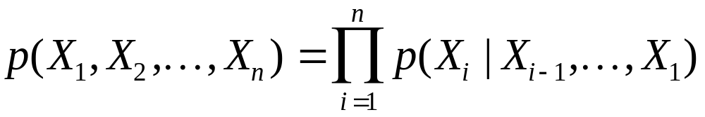
Chaining Cond. Probs.
p(X,Y,Z,W) = p(X | Y Z,W) p(Y | Z,W) p(Z | W) p (W)
The ordering of the r. v.s is not important

Slide 14
Probabilistic Inference
We have random variables X₁, ..., X_{n}
And we know the value of some subset of these: say E subset of {X₁, ..., X_{n} } (for evidence), i.e., we know E = e.
We want p(X_{i} = x_{i} | E = e), for some variable X_{i}

Slide 15
A “brute force” method
We know that p(X_{i} = x_{i} | E = e) = p(X_{i} = x_{i}, E = e)/ p(E=e)
Calculate p(X_{i} = x_{i}, E = e) by summing over all values of the joint prob function in which X_{i} = x_{i} and E = e.
Calculate p(E=e). This could be done in same way.
Intractable for large number of variables:
need all joint probabilities and have to sum over
number of values exponential in n.

Slide 16
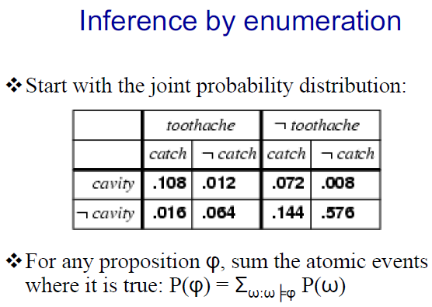

Slide 17
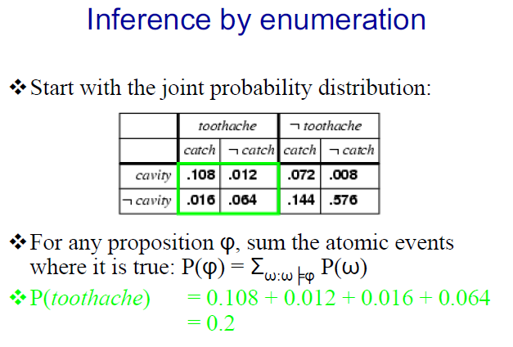

Slide 18
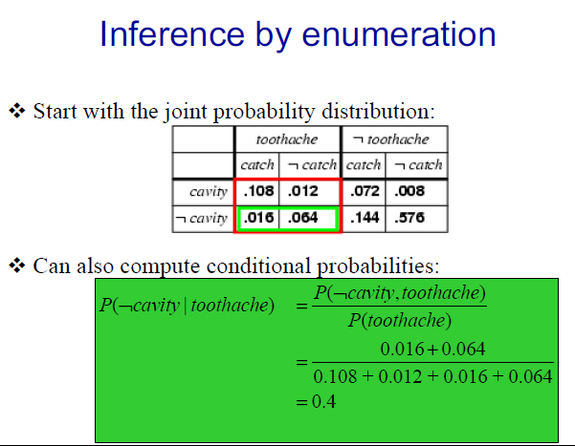

Slide 19
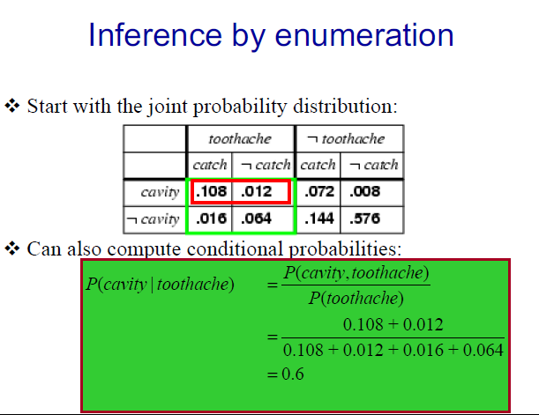

Slide 20
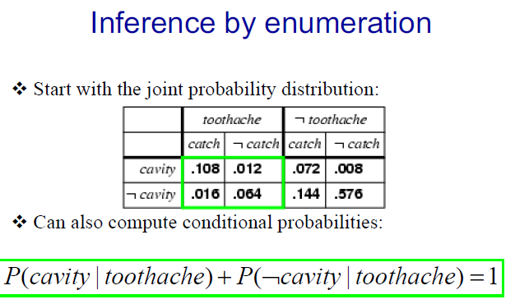

Slide 21
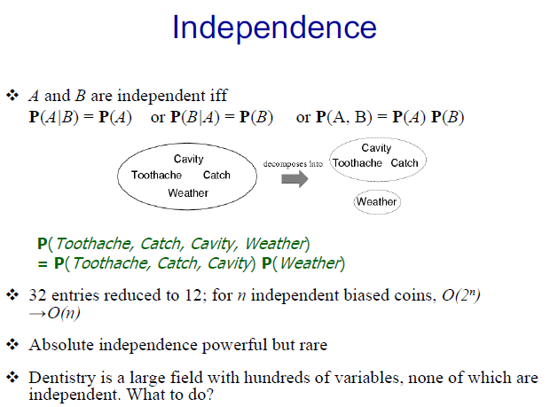

Slide 22
Conditional Independence
A random variable X is conditionally independent of a set of r. vars. Y given a set of r. vars. Z if p(X | Y,Z)=p(X | Z)
Y tells us nothing more about X than we know by knowing Z
As far as X is concerned, we can ignore Y if we know Z

Slide 23
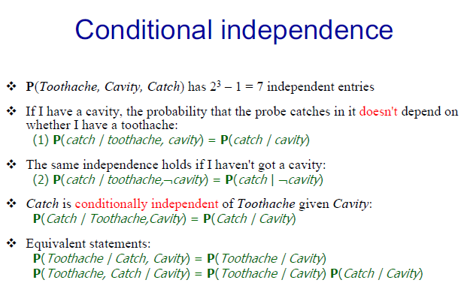

Slide 24
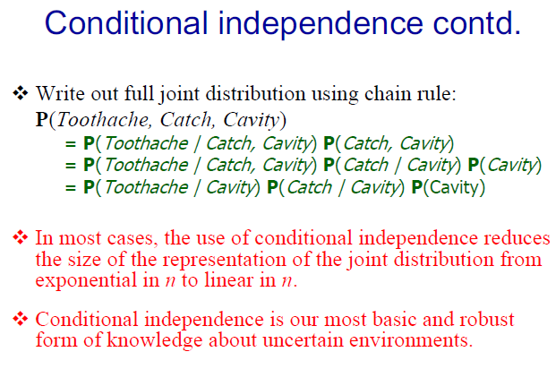

Slide 25
What good is this?
If p(X|Y,Z) = p(X|Z), then we know that
p(X|Y,Z)p(Y|Z) = p(X,Y|Z)
by def. of cond. prob.
Combining the above, we get:
Then
p(X,Y|Z) = p(X|Z)p(Y|Z)
(and note conditional indep. is symmetric)

Slide 26
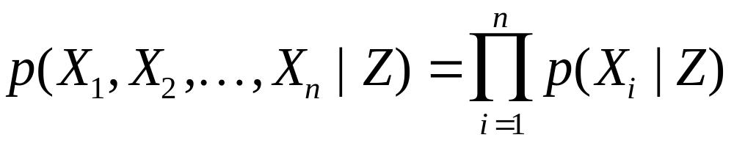
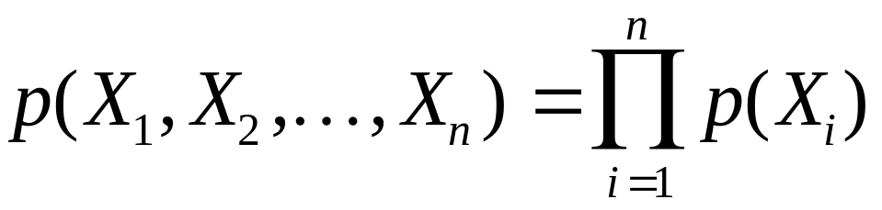
Mutual Conditional Independence
The r. vars. X₁, ..., X_{n} are mutually conditionally independent given Z when each of the vars is conditionally indep of the others given Z. Then we have:
If Z is empty, the vars. are (unconditionally) independent:

Slide 27
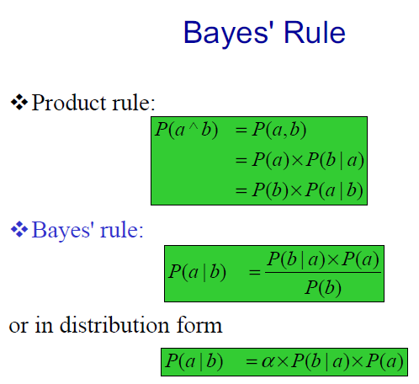

Slide 28
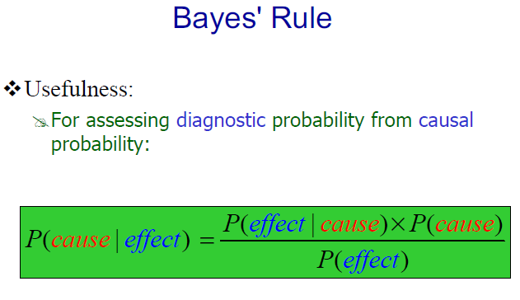

Slide 29
Why is Bayes’ rule useful?
p(object | image) proportional to:
p(image | object) p(object)
p(sentence | audio) proportional to:
p(audio | sentence) p(sentence)
p(fault | symptoms) ...
p(symptoms | fault) p(fault)

Slide 30
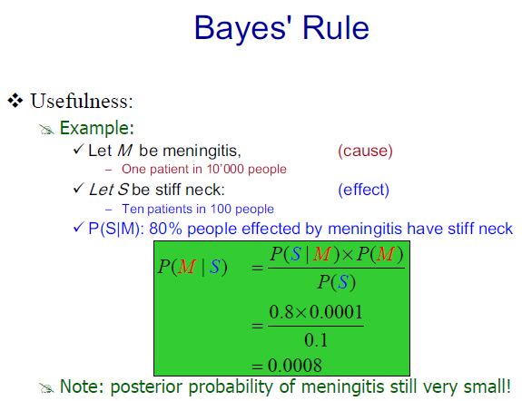

Slide 31
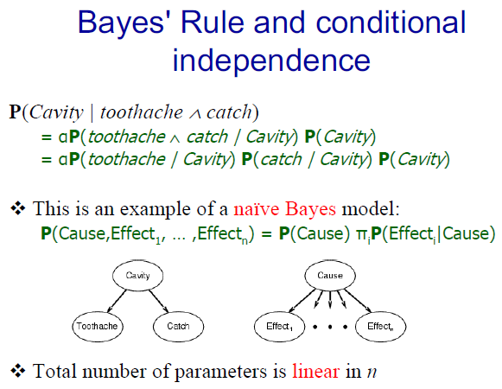

Slide 32
Bayes (or Belief) Networks
Graphical way to represent joint probability functions that takes advantage of conditional independencies among the random variables
Support for more efficient probabilistic inference

